Slide 1
Book Recommendation system
NATIONAL INSTITUTE OF TECHNOLOGY JAMSHEDPUR
Presented By (Group-18) Under the Supervision of
Aryan Sinha (2020UGCS028) Dr. Ashish Kumar Sahu
Ruchi Gautam (2020UGCS074) Assistant Professor
Hariom Kumar (2020UGCS081) Department of Computer Science

Slide 2
Project AIM
The aim of our project is to create a personalized book recommendation system for consumers based on their reading inclinations.
Machine learning techniques will be used by the system to assess user activity and make book suggestions that are relevant to their tastes.
In our work, we are mainly focusing on the past ratings and reviews provided by the user to various books to get best books for each user.

Slide 3
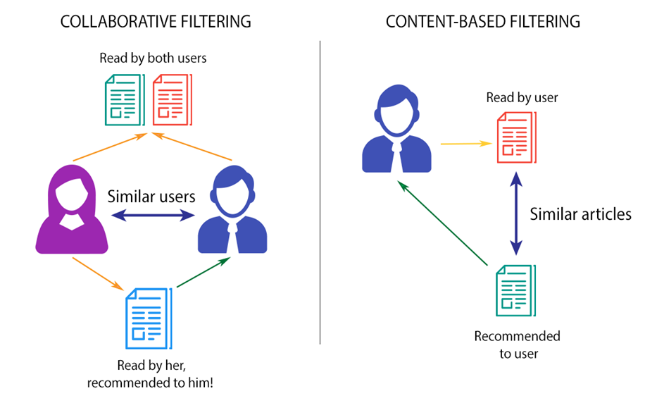
Recommendation system
Recommender systems are the systems that are designed to recommend things to the user based on various factors. These systems predict the most likely product that the users are most likely to purchase and are of interest to.
Techniques –
Content-Based Recommendation System
Collaborative Filtering
Demographic Filtering
Hybrid Recommendation System

Slide 4
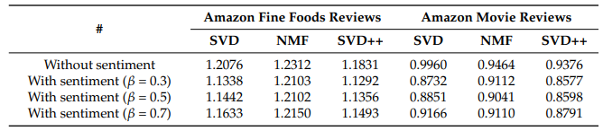
Literature survey
An Approach to Integrating Sentiment Analysis into Recommender Systems [1]
Researchers have used deep learning techniques to perform the sentiment analysis on the users’ reviews and applied Matrix Factorization to build a recommendation system and validated their model on Amazon Fine Food reviews dataset and Amazon movies dataset.
RMSE values without and with L-CNN sentiment analysis model

Slide 5

Literature survey
Recommender System Through Sentiment Analysis [2]
The main goal of this work is to combine both recommendation system and sentiment analysis in order to generate the most accurate recommendations for users.
They have used Semi-Supervised SVM and Collaborative filtering their work.
They have used the following dataset –
English dataset: Tijuana Restaurant dataset, which contains 2000 reviews from 50 guests in 40 restaurants.
French dataset: This dataset contains 10 users, 5 smart phones and 50 evaluations.
Arabic and dialect dataset: This dataset consists of 10 users, 5 oriental clothing for women and 50 evaluations

Slide 6
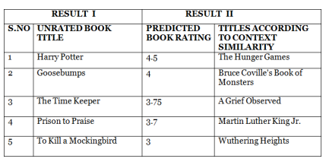
Literature survey
AI based Book Recommender System with Hybrid Approach[3]
They demonstrated a recommendation model that involves Matrix Factorization as a collaborative filtering solution used for providing recommendations.
They have worked on the hybrid recommendation system where they are focusing on various contents and ratings given by the user.

Slide 7
Our proposed work
We have followed the below steps to build the Recommendation System –
Data Acquisition
Data Preprocessing
Sentiment Analysis of Reviews
Training the Different Models
Testing

Slide 8
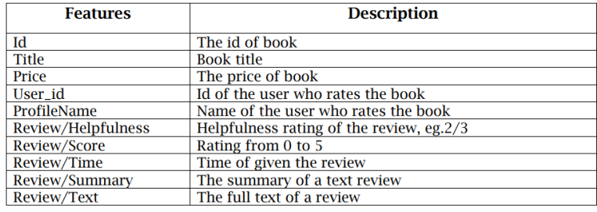
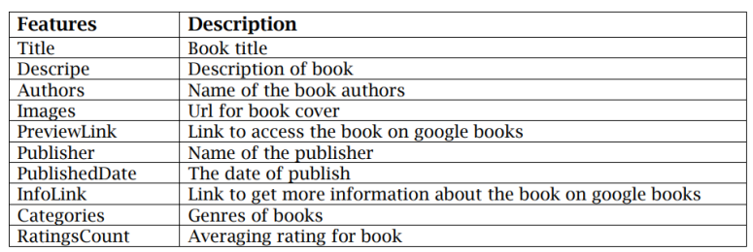
Data acquisition
Amazon Books Dataset
Ratings Metadata
Details about the 3M users ratings on 212404 unique books
Books Metadata
Details about 212404 unique books

Slide 9
Data preprocessing
In our work, we have gone through the following Data Preprocessing Steps –
Dropped the columns which are not going to be used and considered only –
User ID Reviews
Item ID Ratings
Title
Kept only those books which have got at least 50 ratings.
Considered those users who have given at least 200 ratings.

Slide 10
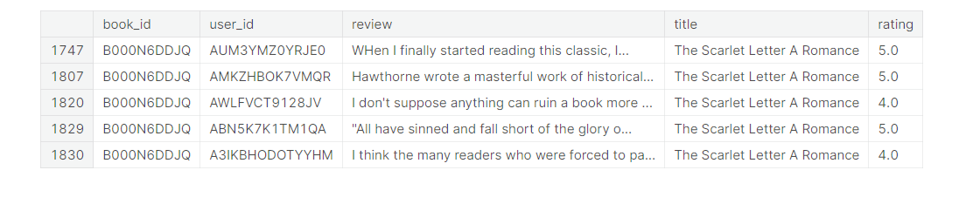
We were left with this dataset after the –

Slide 11
Sentiment Analysis
In recommendation system, sentiment analysis of reviews plays an important role. Employing such an analysis technique can help us to translate the textual comments into an explicit rating which can be used in CF algorithm.
So, to calculate the sentiment score we have used the following two methods –
VADER (NLTK)
BERT (Hugging Face)
After finding the sentiment scores, we removed the outliers i.e. those rows where users have rated high but sentiment score is coming less or vice-versa.
After this we were left with approximate 14000 rows.

Slide 12
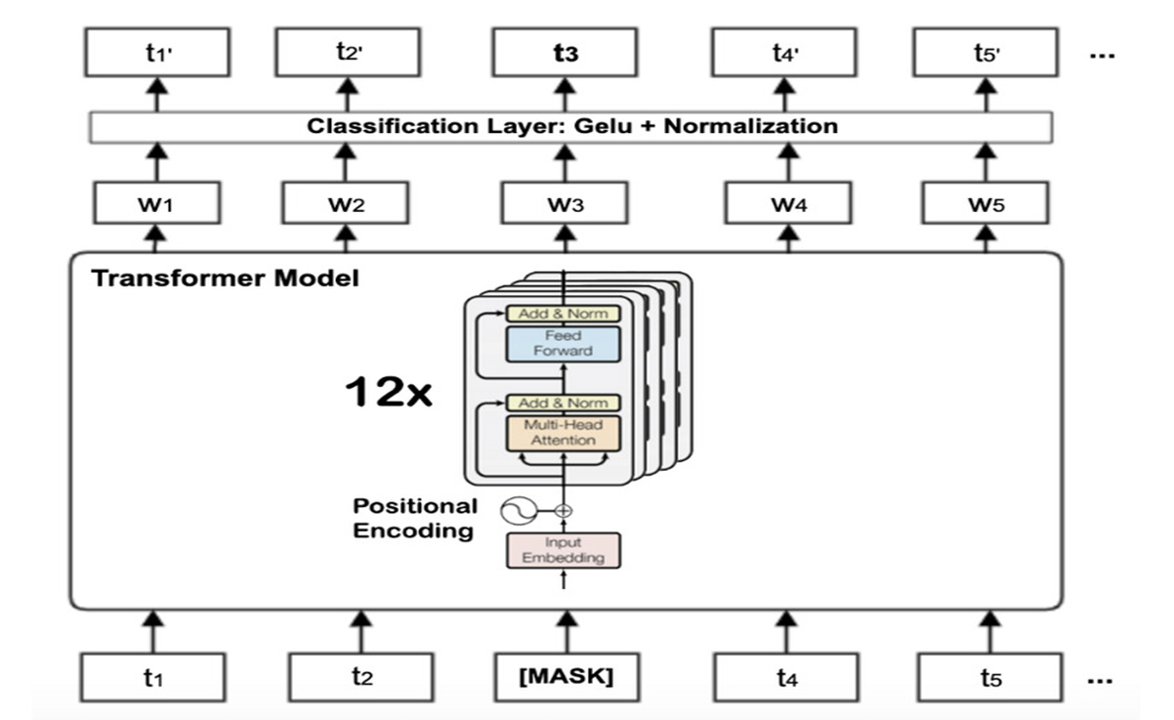
VADER – Valence Aware Dictionary Sentiment Reasoning
BERT – Bidirectional Encoder Representation of Transformer
BERT-BASE MODEL

Slide 13
Training the models
For recommendation system, we have gone through three models –
KNN with Means
Non-Negative Matrix Factorization
Single Value Decomposition

Slide 14
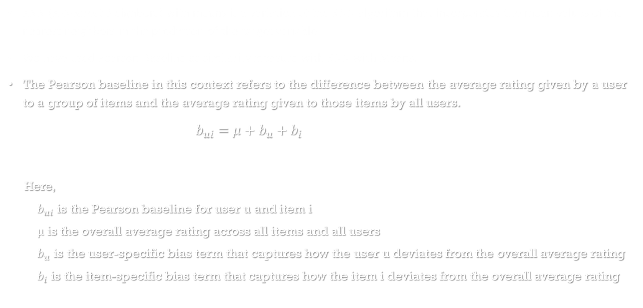
KNN with Means
KNN (K-Nearest Neighbors) with means is a variation of the KNN algorithm that incorporates the mean values of the nearest neighbors in the prediction of the target variable.
We have used Pearson Baseline as similarity measure with KNN with Means.
The Pearson baseline in this context refers to the difference between the average rating given by a user to a group of items and the average rating given to those items by all users.
$b_{ui}=μ+b_{u}+b_{i}$
Here,
$b_{ui}$ is the Pearson baseline for user u and item i
μ is the overall average rating across all items and all users
$b_{u}$ is the user-specific bias term that captures how the user u deviates from the overall average rating
$b_{i}$ is the item-specific bias term that captures how the item i deviates from the overall average rating

Slide 15

KNN with Means
$$b_{u}=\left(\frac{1}{\left|I_{u}\right|}\right)∑\left(r_{ui}−μ\right)$$
$$b_{i}=\left(\frac{1}{\left|U_{i}\right|}\right)∑(r_{ui}−μ)$$
Where,
$\left|I_{u}\right|$ is the number of items rated by user u
$\left|U_{i}\right|$is the number of users who have rated item i
$r_{ui}$ is the rating of item i by user u

Slide 16
Matrix factorization
Matrix Factorization, in recommendation system is a technique to decompose the user-item matrix into two lower dimensional matrices, one for the users and other for the items.
Matrix Factorization helps in finding out the missing value in user-item matrix by capturing the similarity between different other users and items.
In this work we have gone through NMF (Non-Negative Matrix Factorization) and SVD (Single-Valued Decomposition) with the help of Surprise library for Recommendation System.

Slide 17
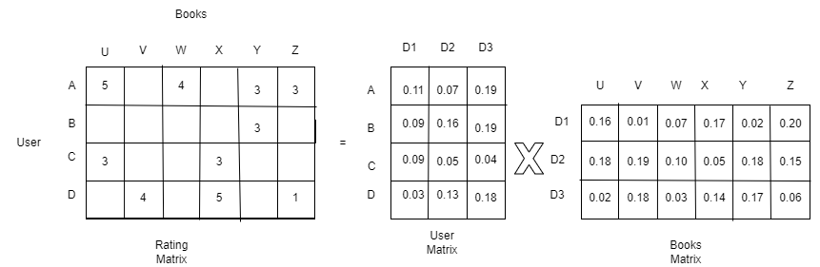
Matrix Factorization

Slide 18
NMF vs SVD
Non-negativity constraint: One of the main differences between NMF and SVD is that NMF enforces a non-negativity constraint on the factor matrices, while SVD does not.
Computational complexity: SVD is generally faster and more computationally efficient than NMF, especially for large matrices. SVD has a well-established mathematical theory and many efficient algorithms for its computation, while NMF can be more challenging to compute, especially when the matrix is high-dimensional.
Loss function: NMF and SVD use different loss functions to measure the quality of the factorization. NMF minimizes the Frobenius-norm of the difference between the original matrix and its reconstruction, subject to the non-negativity constraint. SVD minimizes the sum of squared errors between the original matrix and its reconstruction, without any additional constraints.

Slide 19
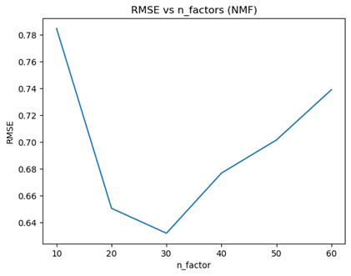
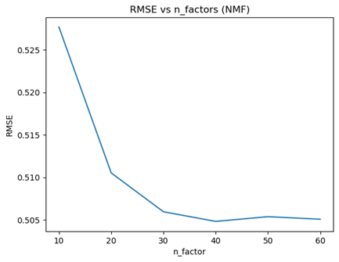
The above graphs are showing how the RMSE was varying with the n_factors value which is a parameter of NMF.
Fig(i) is dealing with VADER (NLTK) sentiment analyzer and Fig(ii) is dealing with BERT Sentiment Analyzer.

Slide 20
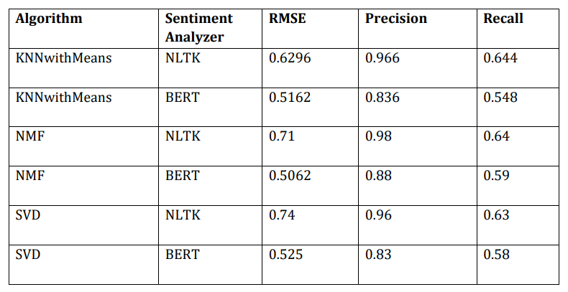
Testing and result
Tested the models on the testing dataset and found the following result –

Slide 21

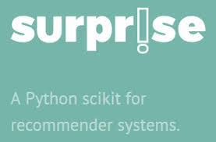





TOOLS

Slide 22
conclusion
Good Recommendation System is very important to give the people best experience and results.
We have tried to built the same and tried few methods to recommend the books to the user including the KNN and Matrix Factorization and this is mainly focusing on Ratings and Reviews given by the users.
We have also focused on the sentiment analysis of the reviews for which we have used two different techniques – VADER and BERT.
The RMSE and precision are pretty good but recall is not so impressive as our result is suffering from Precision-Recall Trade-off.

Slide 23
Future work
After trying several Machine Learning techniques, we can go for the Neural Network method to build the recommendation system.
One popular method to build recommendation system is Neural Collaborative Filtering which uses MLP (Multi-Layered Perceptron) and Matrix Factorization to capture the features and similarity.

Slide 24
Reference
[1]. Cach N. Dang , María N. Moreno-García and Fernando De la Prieta ; Using Deep learning and Matrix-Fatorization [CrossRef]
[2]. Amel ZIANI, Nabiha AZIZI, Didier SCHWAB, Monther ALDWAIRI, Nassira CHEKKAI, Djamel ZENAKHRA, Soraya CHERIGUENE; Recommendation system through sentiment analysis [CrossRef]
[3]. Mercy Milcah Y, Moorthi K. AI based Book Recommender System with Hybrid Approach [CrossRef]

